Slide 1
MATH 241 Recitation
October 22, 2019

Slide 2
AGENDA
SIGN IN
GENERAL ANNOUCEMENTS
DO WORKSHEETS OR GROUP PRACTICE FOR RETAKE (?)

Slide 3
General Announcement
Retake on Thursday and Friday
Have at least 6 hours of help session in order to participate
Exam 2 on November 8 Friday (12 days left)

Slide 4
Worksheets

Slide 5
EXAM RETAKE PRACtICE

Slide 6

LIMIT Problems
$\lim_{x→a}{f(x)}$
Try plugging in where h is approaching to
If you get $\frac{0}{0} or ±\frac{∞}{∞}$ you need to do more work

Slide 7

Limit Practice A
$$\lim_{t→\frac{π}{4}}{tan⁡(x)}$$

Slide 8

Limit Practice A (Solution)
$$\lim_{x→\frac{π}{4}}{\tan\left(x\right)=1}$$
Directly plug in $\frac{π}{4}$ to x
$$\tan\left(\frac{π}{4}\right)=1$$

Slide 9

Limit Techniques
$\lim_{x→0}{\frac{sin⁡(x)}{x}}=1$
Squeeze Theorem

Slide 10

LIMIT PRACTICE PROBLEM (B)
$$\lim_{t→0}{\frac{sin⁡(3t)}{t}}$$

Slide 11

LIMIT PRACTICE PROBLEM (B)
$$\lim_{t→0}{\frac{sin⁡(3t)}{t}}$$
Multiply $\frac{3}{3}$to the limit
$$\lim_{t→0}{\frac{3 sin⁡(3t)}{3t}}$$
Applying the limit sine rule
$$\lim_{t→0}{\frac{3 sin⁡(3t)}{3t}}=3 ∗1=3$$

Slide 12

LIMIT PRACTICE C
$$\lim_{x→∞}{\frac{2−cos(x)}{x}}$$

Slide 13
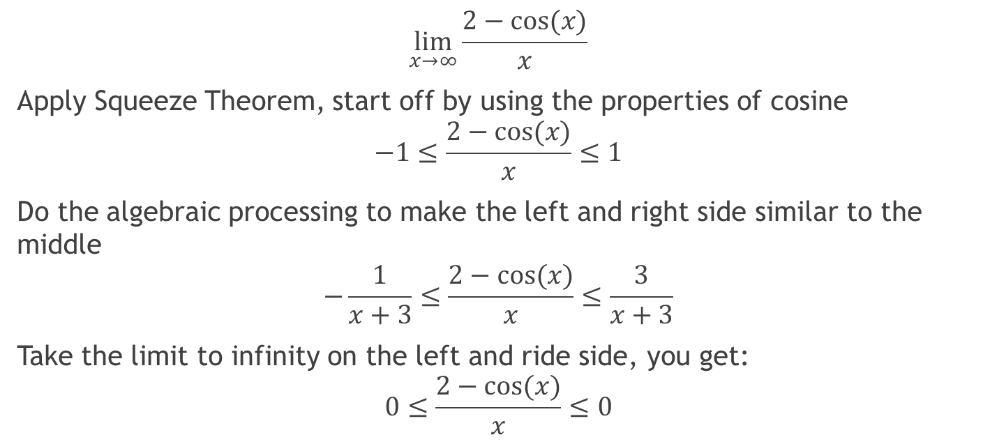
LIMIT PRACTICE C
$$\lim_{x→∞}{\frac{2−cos(x)}{x}}$$
Apply Squeeze Theorem, start off by using the properties of cosine
$$−1≤\frac{2−cos(x)}{x}≤1$$
Do the algebraic processing to make the left and right side similar to the middle
$$−\frac{1}{x+3}≤\frac{2−cos(x)}{x}≤\frac{3}{x+3}$$
Take the limit to infinity on the left and ride side, you get:
$$0≤\frac{2−cos(x)}{x}≤0$$

Slide 14

LIMIT PRACTICE C (SOLUTION)
Therefore by squeeze theorem
$$\lim_{x→∞}{\frac{2−cos(x)}{x}}=0$$

Slide 15
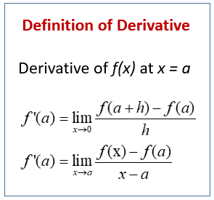
Definition of a Derivative
Derivative of a function tells us the rate of change
A.K.A. Slope
Read the direction of the problem

Slide 16

Practice Problem
Find the derivative of the following function using the definition of the derivative.
$$f\left(x\right)=2x^{2}−16x+35$$

Slide 17
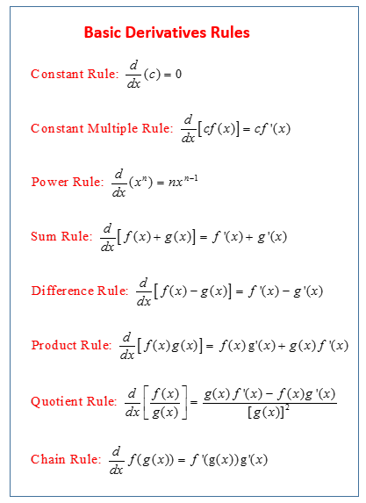
Derivative Properties

Slide 18

Derivative practice A
Find the derivative of the following function:
$$f\left(x\right)=\sin\left(x\right)\left(x^{2}+3\right)+x^{−3}$$

Slide 19
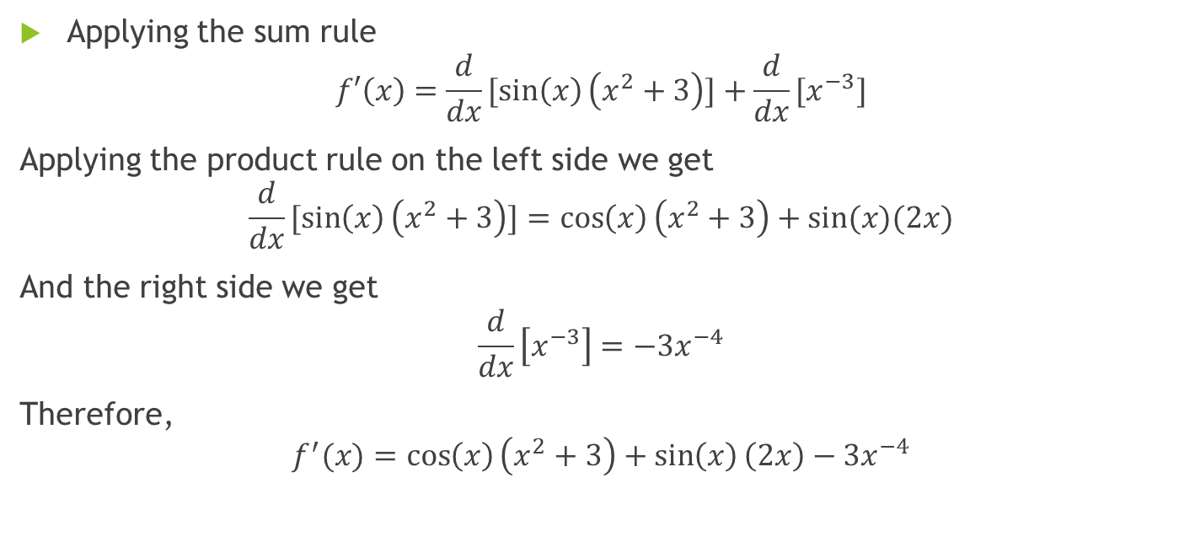
SOLUTION
Applying the sum rule
$$f′\left(x\right)=\frac{d}{dx}[sin\left(x\right)\left(x^{2}+3\right)]+\frac{d}{dx}[x^{−3}]$$
Applying the product rule on the left side we get
$$\frac{d}{dx}[sin\left(x\right)\left(x^{2}+3\right)]=\cos\left(x\right)\left(x^{2}+3\right)+sin⁡(x)(2x)$$
And the right side we get
$$\frac{d}{dx}\left[x^{−3}\right]=−3x^{−4}$$
Therefore,
$$f^{′}(x)=\cos\left(x\right)\left(x^{2}+3\right)+\sin\left(x\right)\left(2x\right)−3x^{−4}$$

Slide 20

Derivative practice b
Find the derivative of the following function:
$$y={\left(12x^{2}+30x^{5}+2x^{−3}\right)}^{100}$$

Slide 21

Solution b
Applying chain rule we start with the outer most part of the function
$$y^{′}={100\left(12x^{2}+30x^{5}+2x^{−3}\right)}^{99}∗\frac{d}{dx}(12x^{2}+30x^{5}+2x^{−3})$$
Taking the derivative of the remaining function:
$$y′={100\left(12x^{2}+30x^{5}+2x^{−3}\right)}^{99}(24x^{1}+150x^{4}−6x^{−4})$$

Slide 22
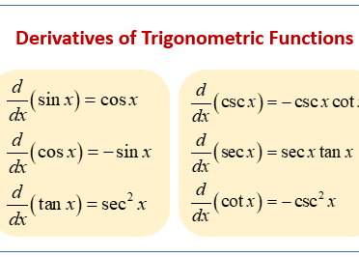

Slide 23

Trig Function Derivative Practice
Find the derivative of the following function
$$f\left(x\right)=\sin\left(x^{3}\right)sec⁡(6x^{4})$$

Slide 24
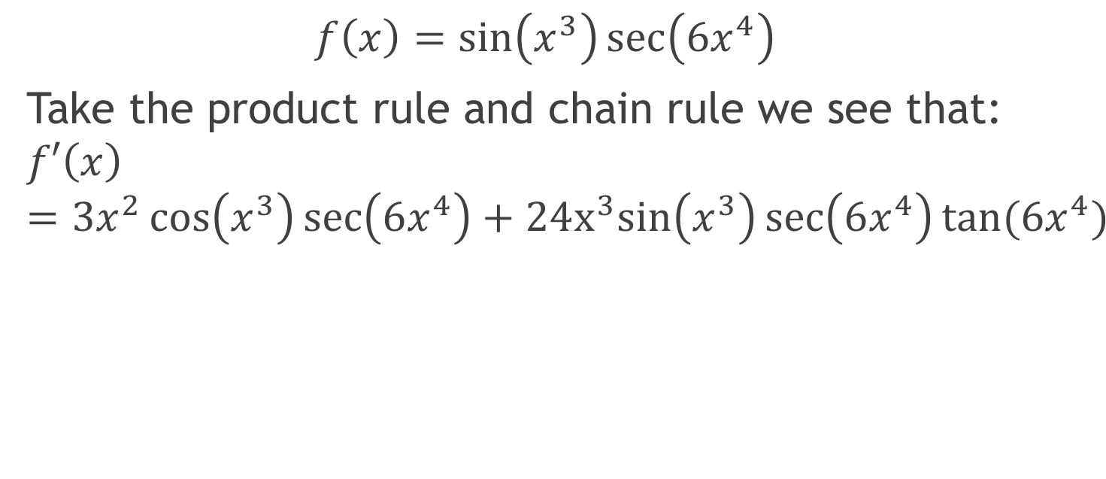
Trig Function Derivative Practice
$$f\left(x\right)=\sin\left(x^{3}\right)\sec\left(6x^{4}\right)$$
Take the product rule and chain rule we see that:
$$f′\left(x\right)=3x^{2}\cos\left(x^{3}\right)\sec\left(6x^{4}\right)+24x^{3}sin\left(x^{3}\right)\sec\left(6x^{4}\right)tan⁡(6x^{4})$$

Slide 25

Tangent line
$$f\left(x\right)=f^{′}\left(a\right)\left(x−a\right)+f(a)$$
f’(a) is the slope at x = a
f(a) is the function at x = a

Slide 26

Tangent line problem
Find the tangent line at f(x)$=15−x^{2} at x=1$

Slide 27
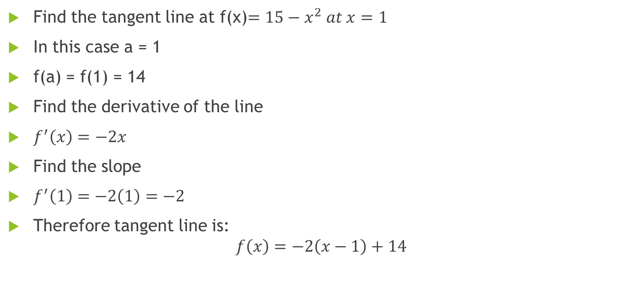
Tangent line Solution
Find the tangent line at f(x)$=15−x^{2} at x=1$
In this case a = 1
f(a) = f(1) = 14
Find the derivative of the line
$f^{′}\left(x\right)=−2x$
Find the slope
$f^{′}\left(1\right)=−2\left(1\right)=−2$
Therefore tangent line is:
$$f\left(x\right)=−2\left(x−1\right)+14$$

Slide 28
Implicit differentiation
There are times where the derivative will not be in terms of x
Sometimes we derive functions in terms of multiple variables

Slide 29

Implicit differentiation practice a
Find y’ at $x^{2}+y^{2}=9$

Slide 30
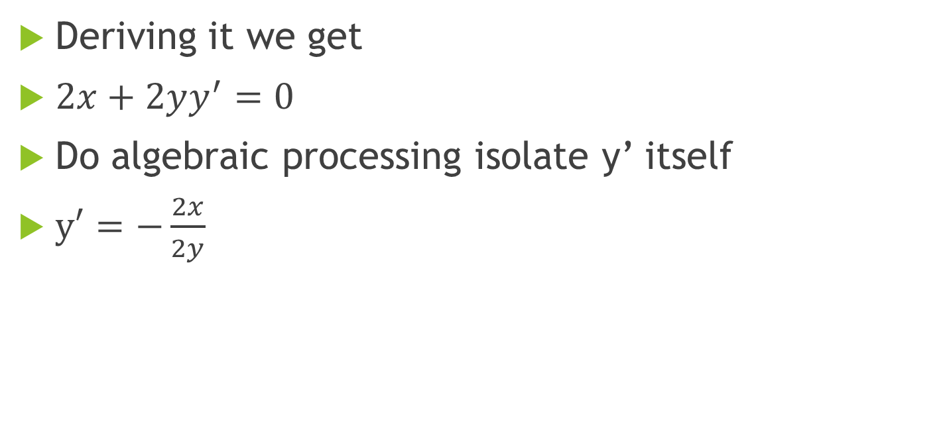
Implicit differentiation practice a
Deriving it we get
$2x+2yy^{′}=0$
Do algebraic processing isolate y’ itself
$y′=−\frac{2x}{2y}$

Slide 31

Implicit Differentiation Practice B
Find the y’ of the following function:
$$x^{3}y^{5}+3x=8y^{3}+1$$

Slide 32

Implicit Differentiation Practice B
Derive the equation using the different rules
$${3x}^{2}y^{5}+x^{3}5y^{4}y′+3=24y^{2}y′+0$$
Do algebraic processing to isolate y’ to one side
$$\frac{3x^{2}y^{5}+3}{24y^{2}−5x^{3}y^{4}}=y′$$

Slide 33
Good source of practice problems
your textbook
https://www.math.ucdavis.edu/~kouba/ProblemsList.html
https://math.hawaii.edu/~yuen/241handouts/
http://tutorial.math.lamar.edu/Classes/CalcI/CalcI.aspx

